Slide 1

Living in Barcelona:
How to move around the city safely?
Mariana Donabella & Carlos Martinez
Notes:
Hello! We are Mariana and Carlos and we want to talk about TITLE
we both come from South America, Mariana is from Sao Paulo Brazil and I come from Caracas Venezuela

Slide 2
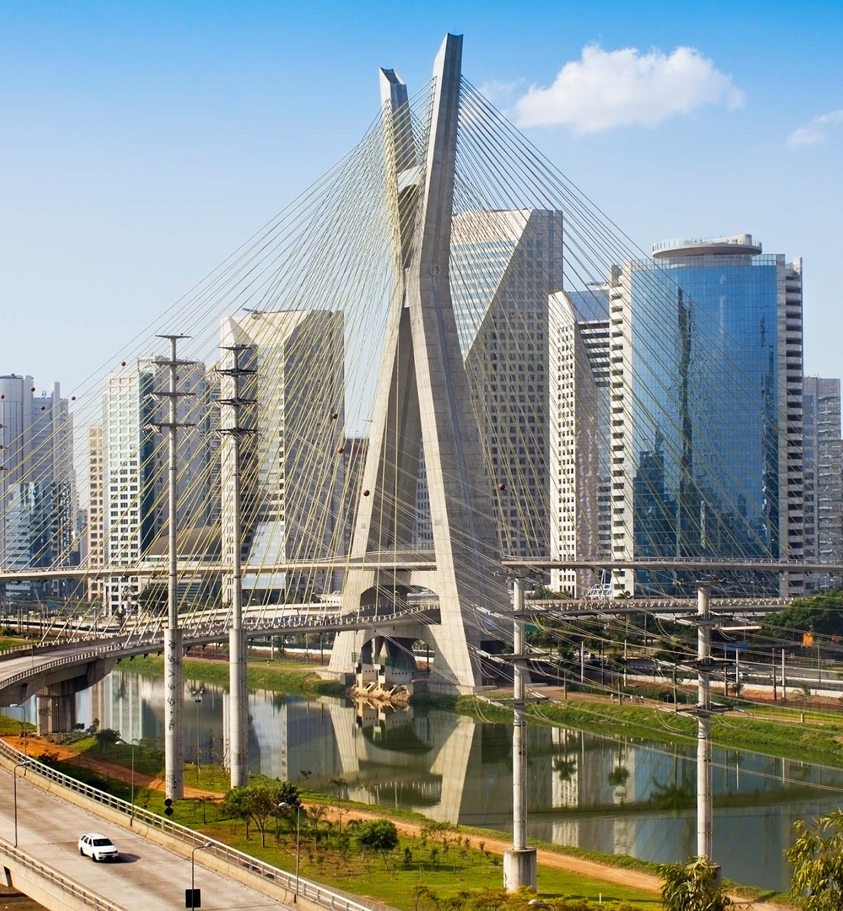
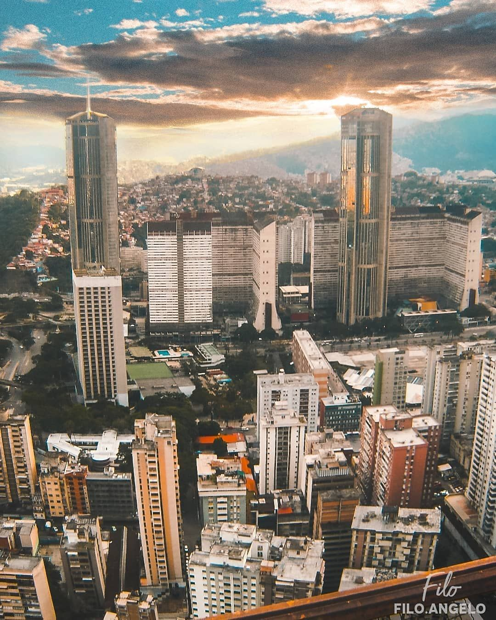
São Paulo, Brazil
Caracas, Venezuela
Notes:
Our cities are pretty hectic but we are locals and we know how to move around our cities. We know which neighborhood is really busy and which neighborhoods are more susceptible for accidents.

Slide 3
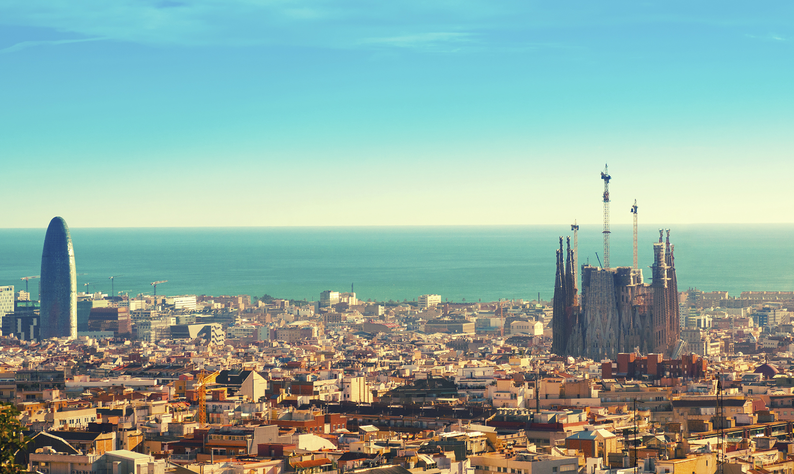
Barcelona, Spain
Notes:
But we just arrived to wonderful Barcelona for our bootcamps and have very little knowledge of the city transportation and how people move around. We were a little uncomfortable by this so we decided to do some research!

Slide 4
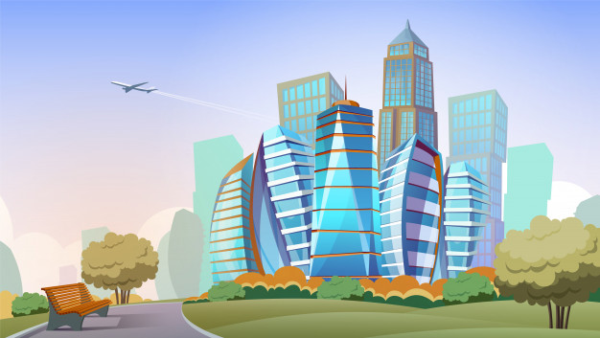
Accidents reported in the city
Accidents = occurrences.
Accidents with seriously injured victims =2%
2019
19037 accidents reported.
52 reported a day.
Notes:
We searched for some data and found the report of accidents in 2019! We cleaned the data and started analyzing the dataset in general and then started to narrow it down to answer our questions.
Accidents in our cities are defined as real accidents like seriously injured people, here in Barcelona they are occurrences the dont involve serious
We know that in 2019 over 19 thousand accidents were reported which is around 52 accidents a day, is this normal? Is it high or low? So we decided to compare it with 2018 and noticed that they were almost identical. We wanted to see the report of accidents in 2020 but didn't find any, but who wants to remember 2020 anyway?
What were involved in these accidents? We saw a lot of cars and motorcycles but we were amazed by the amount of bicycles and electric scooters in the city. Let’s see,

Slide 5
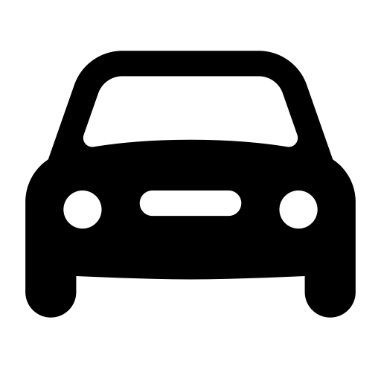


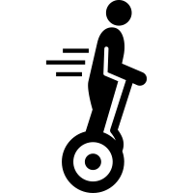
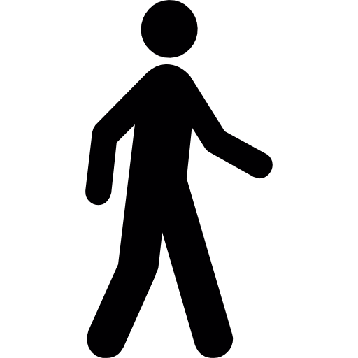




What is involved in these accidents?
Vehicle Type:
43%
6%
96%
36%
3%
Fun Facts:
21%
14%
Notes:
Ok so most of the accidents involved cars followed by motorcycle. We see that bicycles and electric vehicles like scooters represent a combined 6% of the accidents. There are more accidents involving bicycles than public transport! What about pedestrians?
Fun facts...

Slide 6



When do these accidents occur?
Weekends
Saturday 10%
Sundays 8%
Weekdays
From Monday to Friday 16%
Friday is the day where most accidents occur
Monday is the day where less accidents occur
Time of the Day
10%
38%
50%
Notes:
Ok we know what is involved in these accidents. But when do they happen? We thought it would be during weekends, when people party, go out of the city, do some exercise,… but no! Just 18% of accidents occur on weekends, the rest happens during the week and most of the accidents are well distributed by days. But friday is where most of these accidents happen. We guess people are excited about the weekend!
We also thought that most accidents happened during the night, you know, people drinking and driving, less visibility but we were wrong again. Its during the afternoon! So friday afternoon! What a way to start the weekend...
Most of accidents occur on friday
16.6% occurred on Fridays.
16.5% occurred on Wednesdays.
16.3% occurred on Thursdays.
16.2% occurred on Tuesdays.
14.9% occurred on Mondays.
10.8% occurred on Saturdays.
8.2% occurred on Sundays.

Slide 7
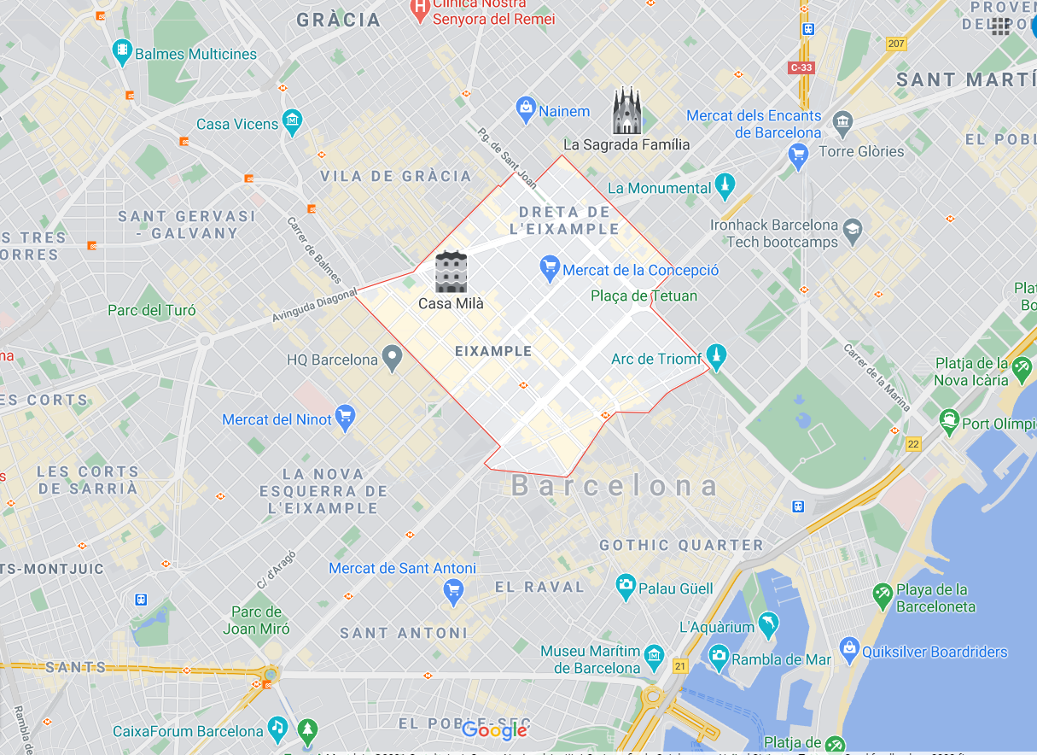

Accidents in Barcelona:
When do they happen
How serious they are
Who is involved
Color of vehicle!!
Where??
Notes:
2240 reported accidents, 11.7%
l'Antiga Esquerra de l'Eixample is 2nd with 1109 or 5.8%
Ok, so now we’ll tell you what we found out:
Note: this data is analyzing all of the accidents reported from authorities in 2019.

Slide 8


Neighborhood with most accidents reported:
la Dreta de l'Eixample
La Dreta de l’Eixample Total of accidents | 2240 / 6 per day
La Dreta de l’Eixample share of accidents | 12%
l’Eixample share of accidents | 30%
Notes:
2240 reported accidents, 11.7%
l'Antiga Esquerra de l'Eixample is 2nd with 1109 or 5.8%
Ok, so now we’ll tell you what we found out:
Note: this data is analyzing all of the accidents reported from authorities in 2019.

Slide 9



So we already know, we do NOT want to be:
In la Dreta de l'Eixample
On a friday afternoon
Near a white car or motorcycle
Notes:
Carlos and I now know where and when to be careful here: La Dreta deixample, friday afternoons, stay away from white cars!!. But well if you pass through Can Peguera a lot you don’t need to worry much, they only had 9 accidents reported the whole year so you might even try to walk with your eyes closed in there!

Slide 10
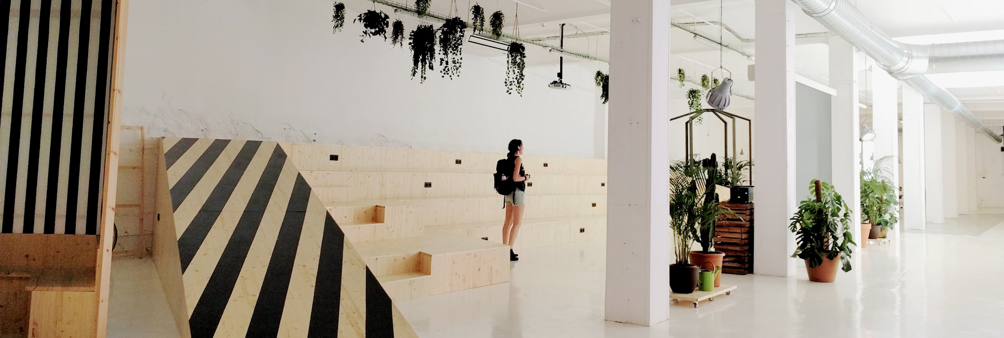
Ironhack’s neighborhood:
el Parc i la Llacuna del Poblenou
Accidents: 0,72 per day, most of them during the morning!
.
Notes:
Well and if you are coming to campus, you’re probably safe! In this neighborhood, the average of accidents per day is only x, so you will probably be just fine

Slide 11
Thank you!
Any questions?
Notes:
Well and if you are coming to campus, you’re probably safe! In this neighborhood, the average of accidents per day is only x, so you will probably be just fine

